Slide 1
Quick and Dirty Dozen: Get Started on UDL
Seanna Takacs, PhD
Educational Consultant

Slide 2
options mitigate barriers

Slide 3
ACTIVITY x MODALITY
ACTIVITY (assessment) | MODALITY (method of demonstration)
essay presentation discussion poster exam | visual auditory kinesthetic

Slide 4
ONE
use an assessment tool (or develop your own) for both formative and summative evaluation.

Slide 5
TWO
digitize as much as possible

Slide 6
THREE
The Concept Interview
definition = concept
Flesh out conceptual context;
imbeddedness
relationality

Slide 7
FOUR
Collaborative Vocabulary Study
identify
define
conceptualize
use/misuse
represent

Slide 8
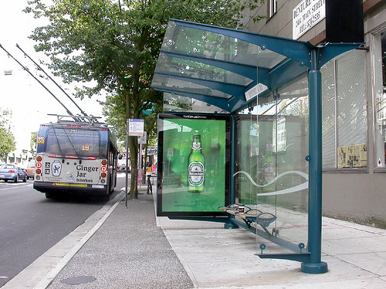
FIVE
The Bus Stop Conversation
colloquial
formal

Slide 9
SIX
The Emergent Expert Conversation
Can you be considered an expert in anything?
What are you becoming an expert in?
How will this course help?
How would you like this course to help?

Slide 10
SEVEN
Record Your Lectures
Use the recording for analysis & reflection

Slide 11
EIGHT
My (Academic) Superpower
Conceptualising
Taking exams
Analysing
Synthesising
Writing
Reading
Critiquing
Perspective-taking
Presenting Ideas
Organizing
Technology
Academic nemesis?

Slide 12
NINE
Demonstrate Knowledge Flexibly
Paper
Exam
Slideshow
Journal response
Painting
Pottery
Demonstration
Field work
Action research
CAUTION!
Think first about the type of knowledge acquisition you are supporting.

Slide 13
TEN
What I Actually Mean (WIAM)
1. ATTEMPT FORMALITY
2.Provide the opportunity to reword, rewrite, explain meanings, and reflect as a way of moving towards mastery of formal academic language.
3. ATTEMPT FORMALITY

Slide 14
ELEVEN
The Hotwash
Immediate debrief end of class for 10 MINUTES
Students distill the class
Students describe strengths and weaknesses
Instructor takes notes
Follow-up next class - refer back to the Hotwash for further reflection/integration

Slide 15
ONE DOZEN
Assessment Design vs Assessment Climate
“Let’s all make mistakes!”
Normalize mistakes by pointing to common errors
Frequent, low stakes, low cost understanding checks

Slide 16
Staying in touch!
EMAIL: tlcommons@kpu.ca
TWITTER: @KPU_TLCommons
WEBSITE: kpu.ca/teaching-and-learning
BLOG: wordpress.kpu.ca/tlcommons/
PODCAST: anchor.fm/kpu-tlcommons

