Slide 1


UDL: The Basics
Dr. Seanna Takacs
Educational Consultant, UDL

Slide 2
Universal Design for Learning is a design framework to help all students become resourceful, reflective, strategic learners using multiple pathways to get to firm learning outcomes.

Slide 3
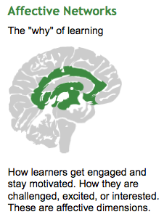
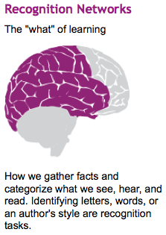
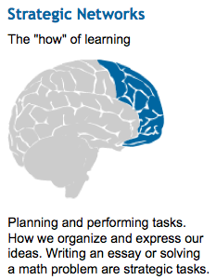

Slide 4
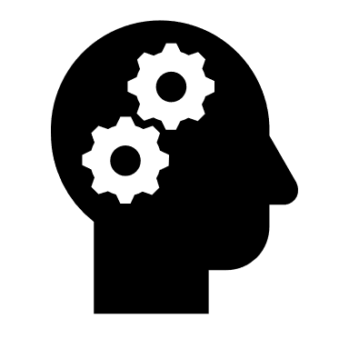
Who Are You Teaching?
Skill
Technology
Preferences
Strengths
Language
Culture
Educational experiences
EXPERT LEARNERS

Slide 5
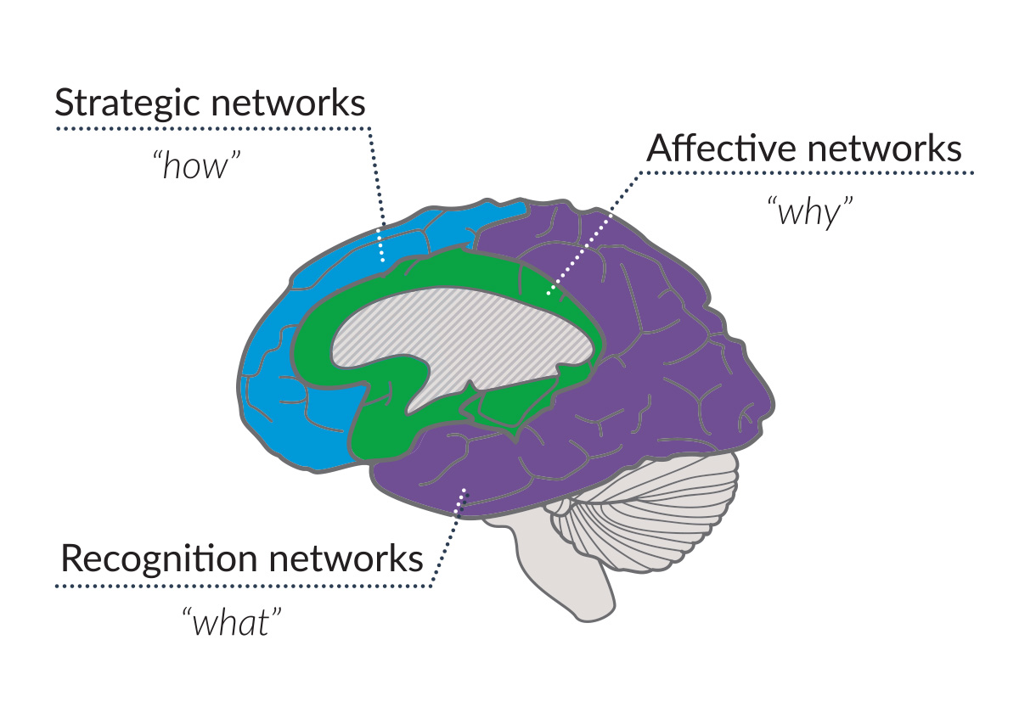
Why Are We Learning This?
Be explicit about learning expectations and rationale;
Design for opportunities to set and reflect upon goals;
Design meaningful activities and solicit regular feedback;

Slide 6
What Are We Learning?
Design for multiple ways of learning course content;
Create tasks to identify vocabulary, find errors, and manipulate concepts;
Use reading, video, construction, and observational tasks;

Slide 7
How Can Students Show Learning?
Design for multiple ways of showing learning;
Students can write essays and tests, create videos, storyboards, scripts, art, blog posts, etc.;
Multiple pathways help students develop competence and support deep engagement.

Slide 8





 | Are there clear learning goals aligned with course learning outcomes?
 | Before the course begins do students have the opportunity to self-reflect on the course content and their background knowledge?
 | Do students have options around the methods and materials they will use to learn the course content?
 | Are there ways that students can monitor their progress, self-reflect, optimize challenge, and seek additional support?
 | Do students have options and choices for how they will demonstrate their knowledge?
If you answered YES to all five questions, then you have universally designed a lesson to a specific learning outcome!
* Adapted from Katie Novak, Novak Consulting

Slide 9

Dr. Seanna Takacs
Educational Consultant, UDL
Teaching and Learning Commons
Kwantlen Polytechnic University
seanna.takacs@kpu.ca

