Slide 1
Accommodations 101
Seanna Takacs, PhD
Learning Specialist, Accessibility Services
Educational Consultant, UDL

Slide 2
What is a Disability?
Definition according to BC Human Rights/Ministry of Justice:
A disability is a condition that limits a person’s senses or activities.
It may be physical or mental, visible or invisible.
What do they mean by limit? Who or what is doing the limiting?

Slide 3
The Social Model of Disability?
MEDICAL MODEL - disability or illness is an intrinsic part of the individual that can cause disadvantages and can impact daily life.
SOCIAL MODEL - barriers in society are the problem, rather than the individual or the condition. Society needs to change, rather than individuals with disabilities.

Slide 4
What is a Barrier?
A characteristic of a person or environment
Everyone experiences barriers
DISABILITY-RELATED barrier

Slide 5
PAUSE
LIST FIVE BARRIERS YOU HAVE WITNESSED FOR STUDENTS

Slide 6
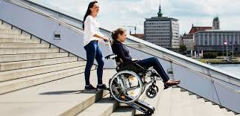
What is a Functional Limitation?
An experience of the person
A limitation in a particular context as a result of their disability

Slide 7
Who “Decides” About Disability?
Formal diagnosis
physician/specialist
psychologist
Psychiatrist
Must include a report on the functional limitations the student experiences as a result of disability.

Slide 8
Academic Accommodations
A means of mitigating disability-related barriers (i.e., functional limitations) in the academic environment
class materials
lectures, activities
field work, practica, exchanges

Slide 9
Human Rights
Instructors are bound by human rights legislation to provide academic accommodations when a student’s needs are based on Protected Grounds (i.e., disability)
Example: An instructor may give everyone extra time, but that doesn’t mean a person with a disability is appropriately accommodated.

Slide 10
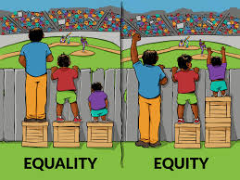
Giving everyone the same resources, funding, support.
Differentiating resources, funding, support based on need.
Accommodations can be thought of as the “boxes” students use to see over the fence (i.e., to access sightlines for the game).

Slide 11
Accommodations + Learning Outcomes
Note that a fundamental alteration to course outcomes must never occur, according to Ministry guidelines.

Slide 12
Troubling Behavior
calling out
copious questions
disrupting the class
crying
absenteeism
threats
aggression
academic integrity

Slide 13
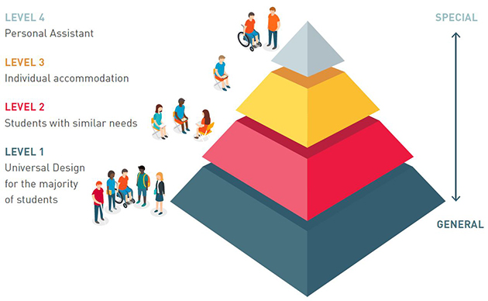
What’s UDL?

Slide 14
How Can I Help?
Ask how you can help!
Read the accommodation letters
Introduce yourself
Say, “I’m here to help, please talk to me anytime”
Partner with Accessibility Services
Maintain a process orientation

Slide 15
If You Need Help
Accessibility Services
Early Alert
Student Rights and Responsibilities Office

Slide 16
Staying in touch!
EMAIL: tlcommons@kpu.ca; seanna.takacs@kpu.ca
TWITTER: @KPU_TLCommons
WEBSITE: kpu.ca/teaching-and-learning
BLOG: wordpress.kpu.ca/tlcommons/
PODCAST: anchor.fm/kpu-tlcommons

